Slide 1


+
PROJ 602 - Capstone Project
International Student Management System
(ISMS)
Software Developer Program – Summer 2022

Slide 2

Content
Introduction
Methodology
Sprints
System presentation
Conclusion
Q/A
2

Slide 3
INTRODUCTION
Develop a software application for international student advisors
Keep track day-to-day conversations with students
3

Slide 4
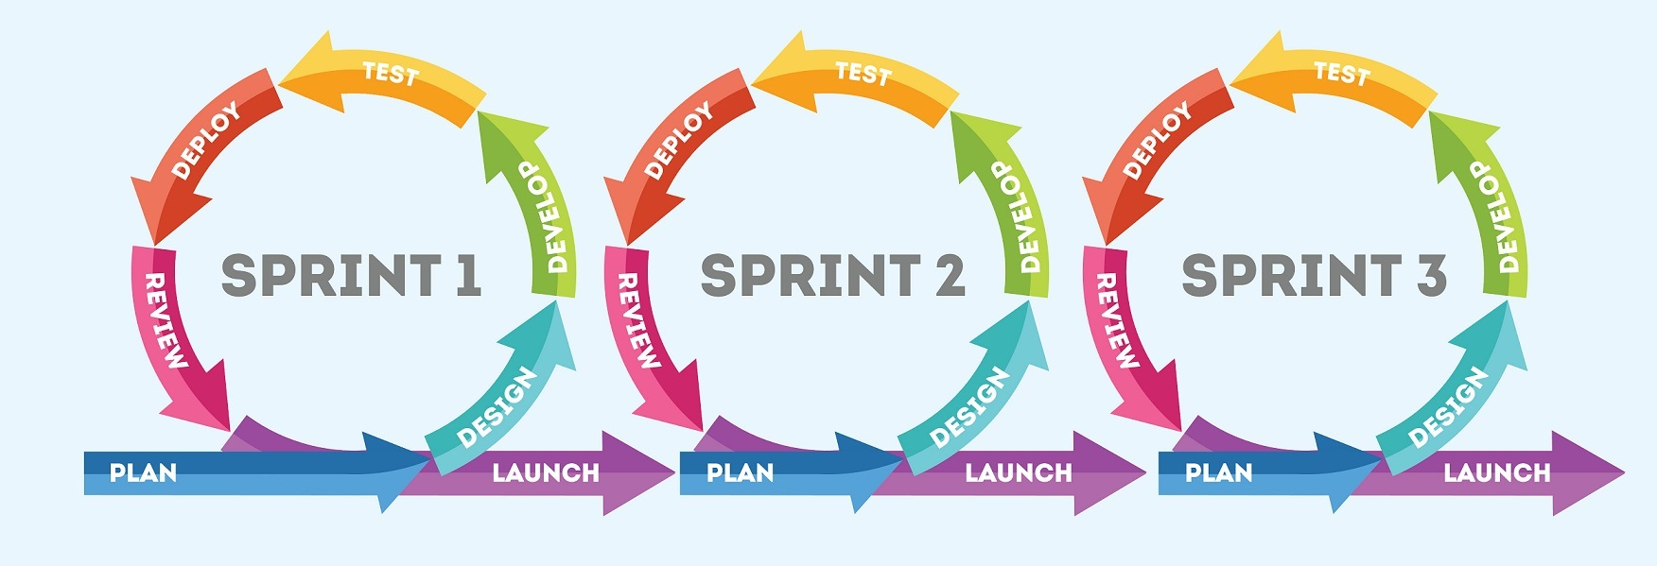
Methodology and software Engineering
Agile
4
Notes:
Notes....

Slide 5
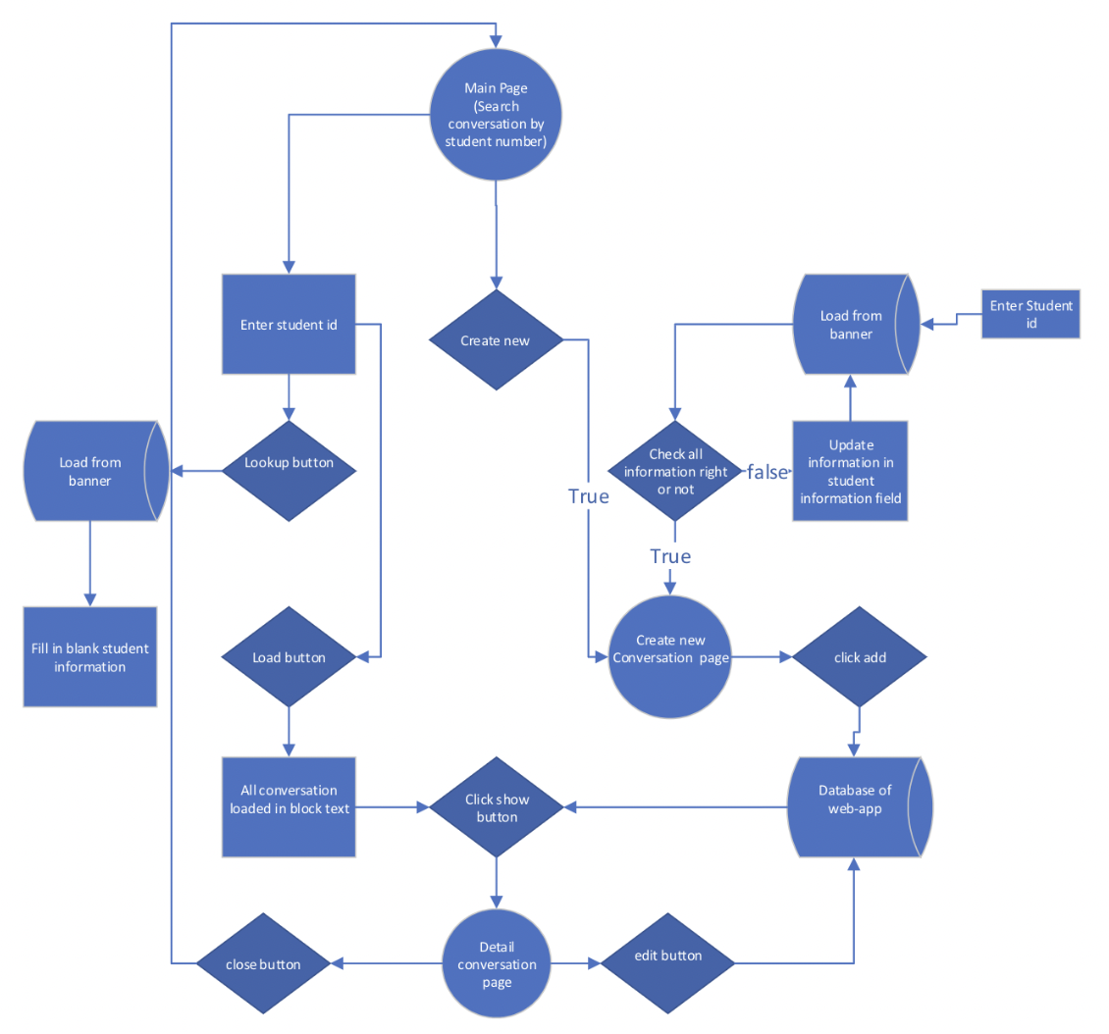
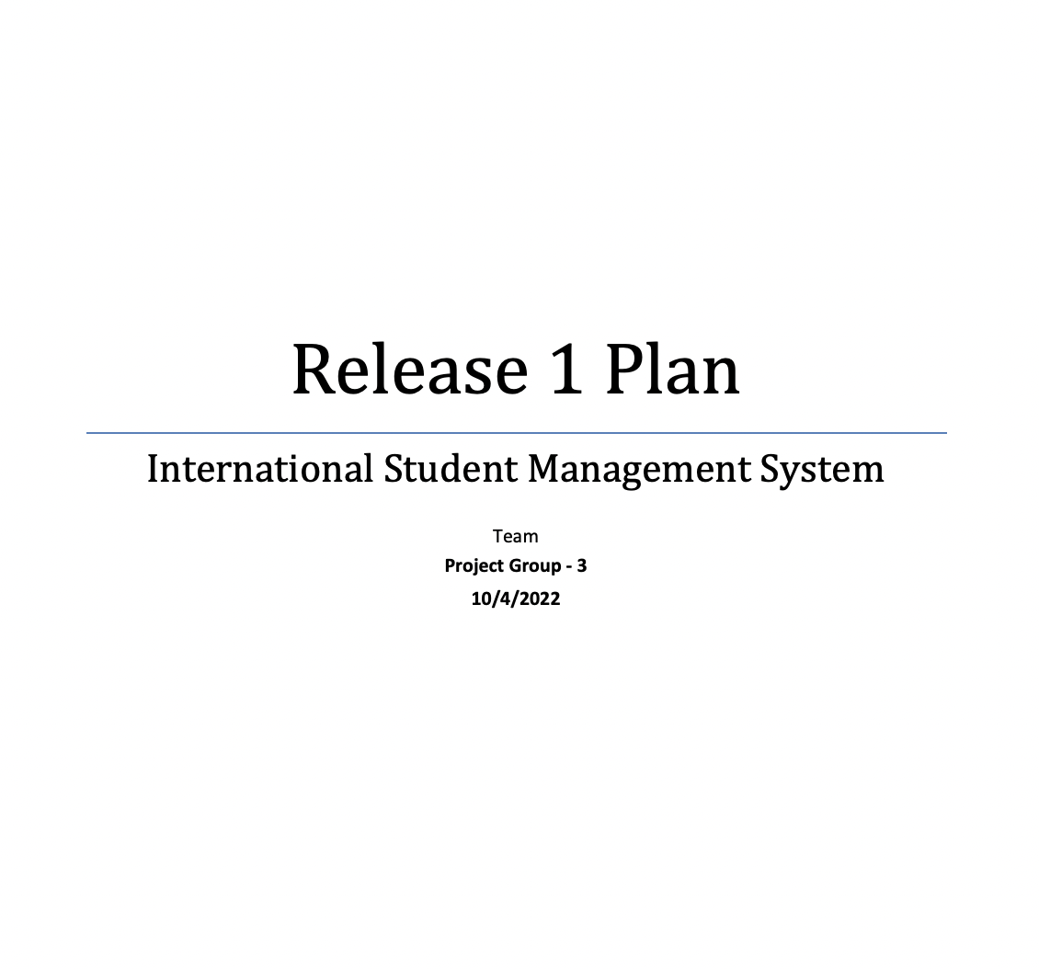
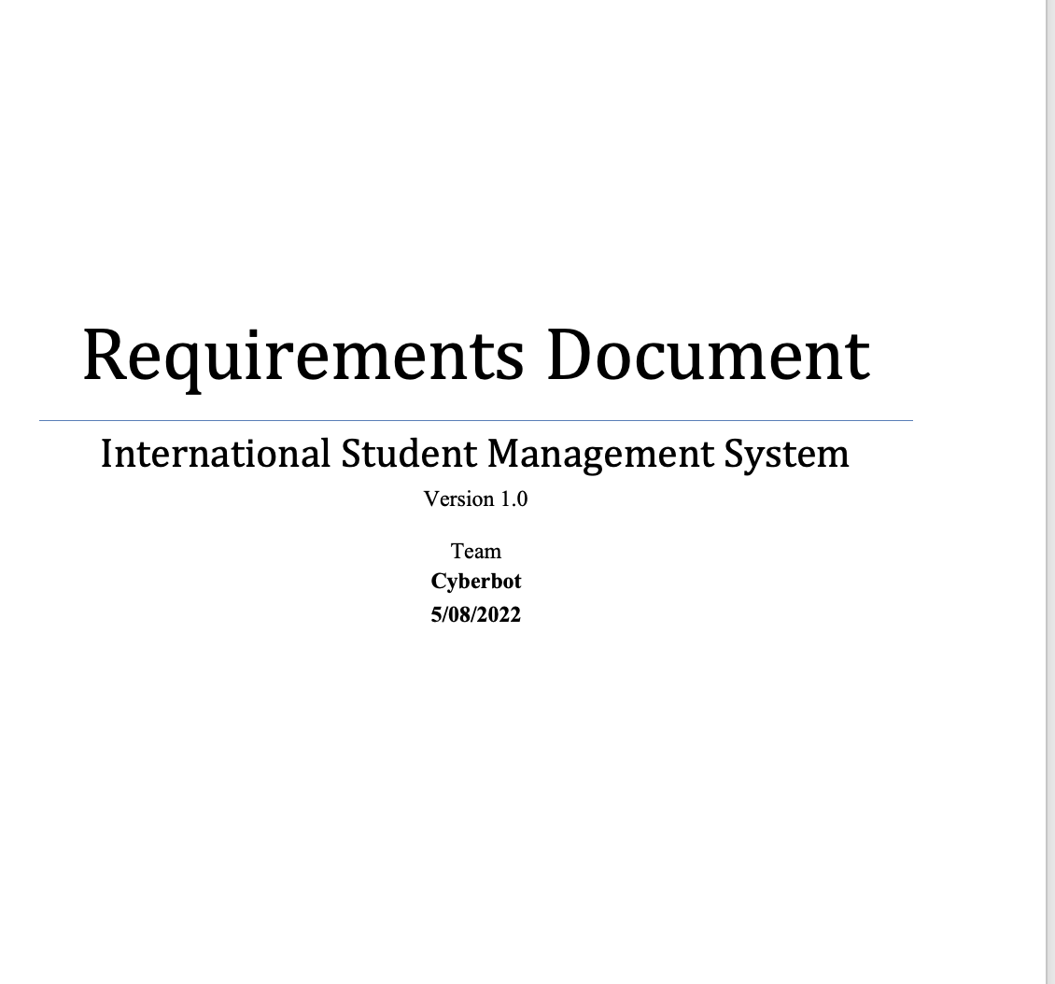
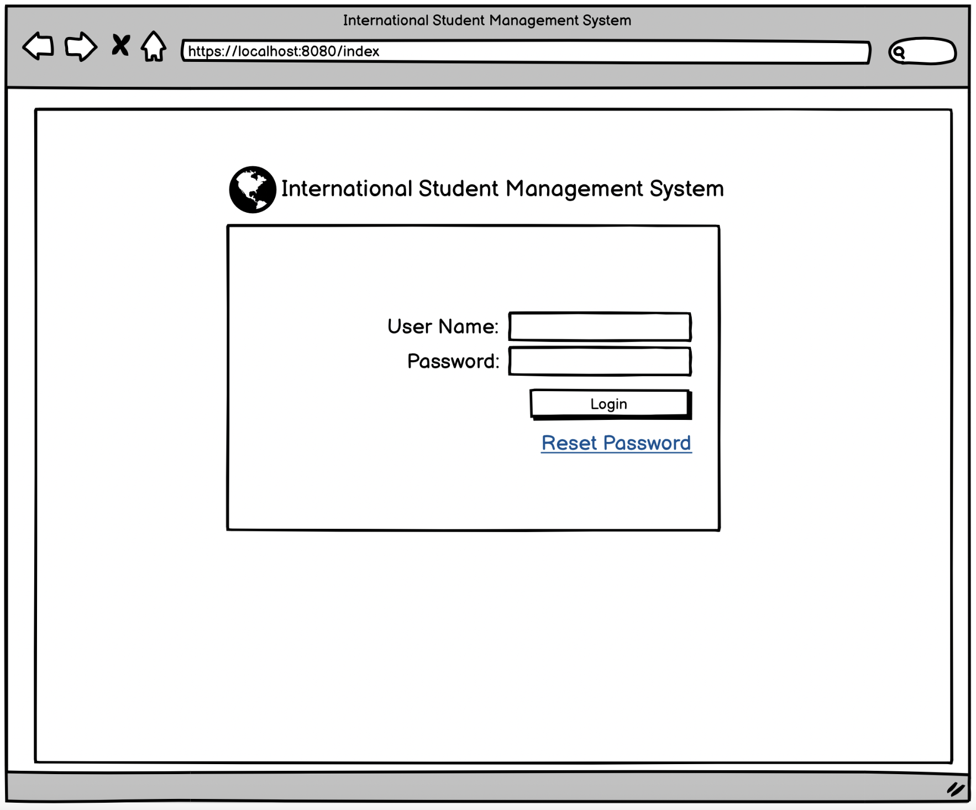
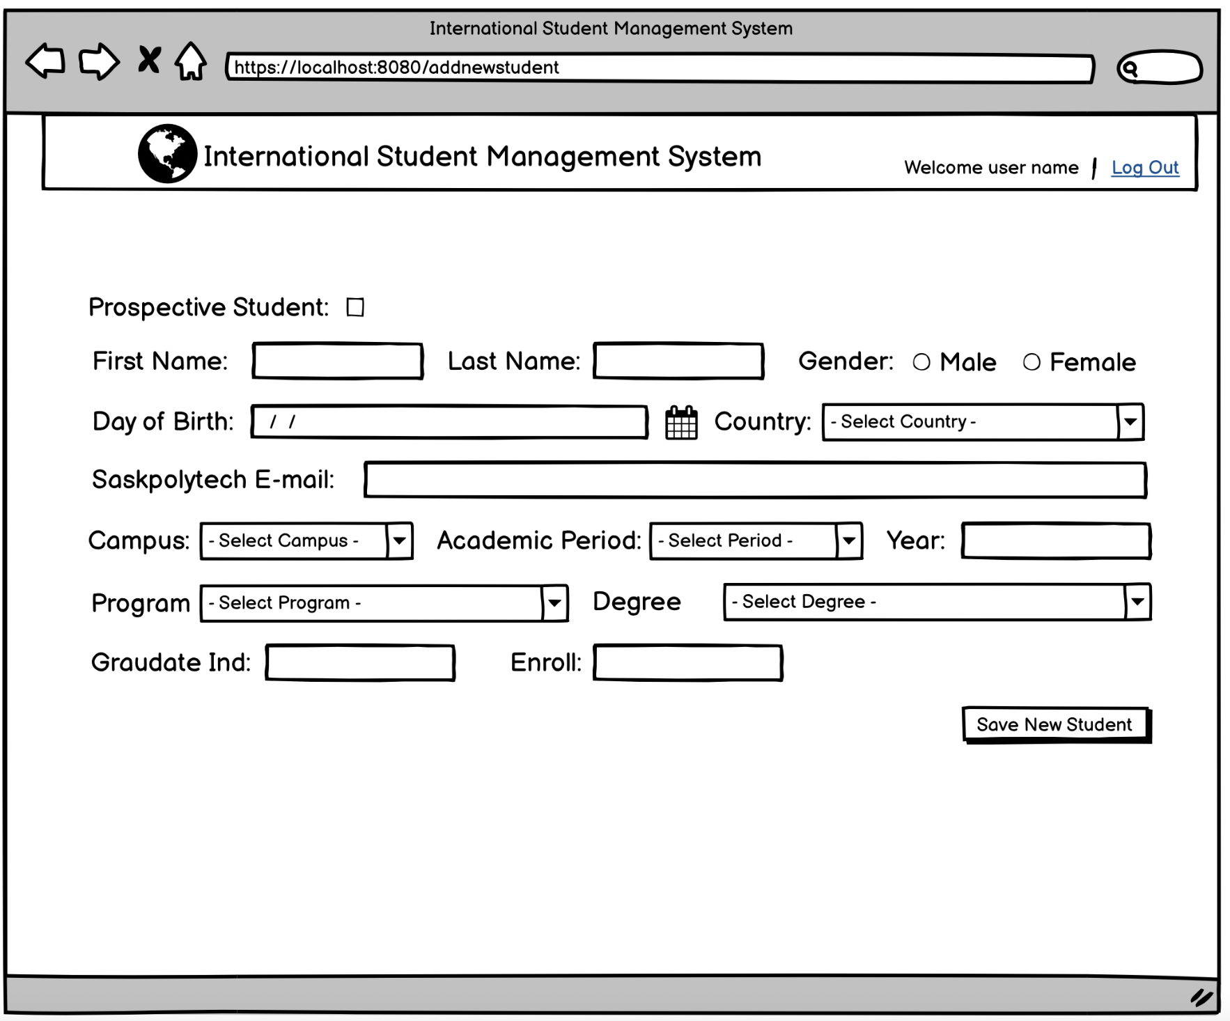
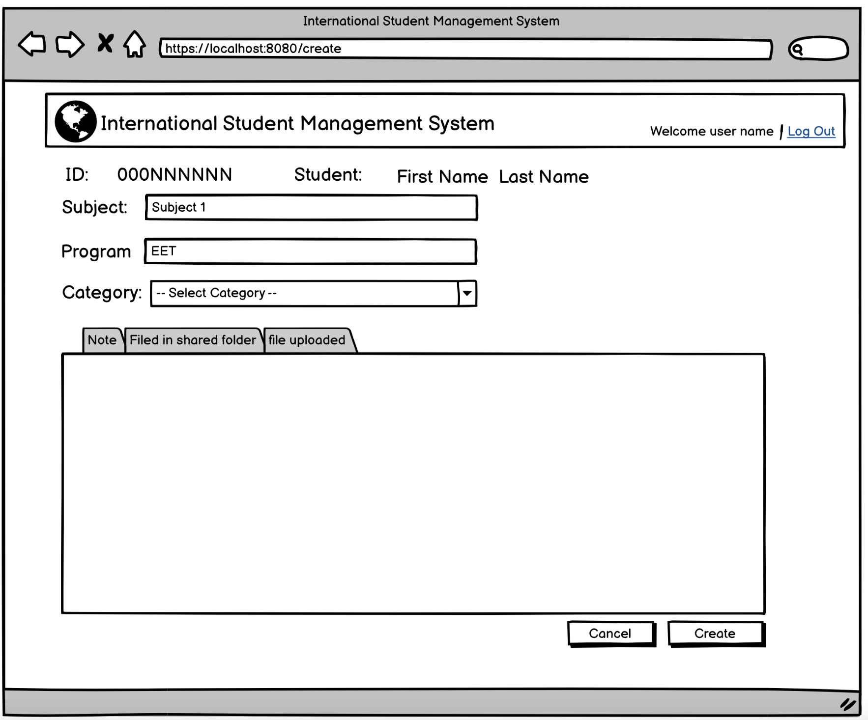
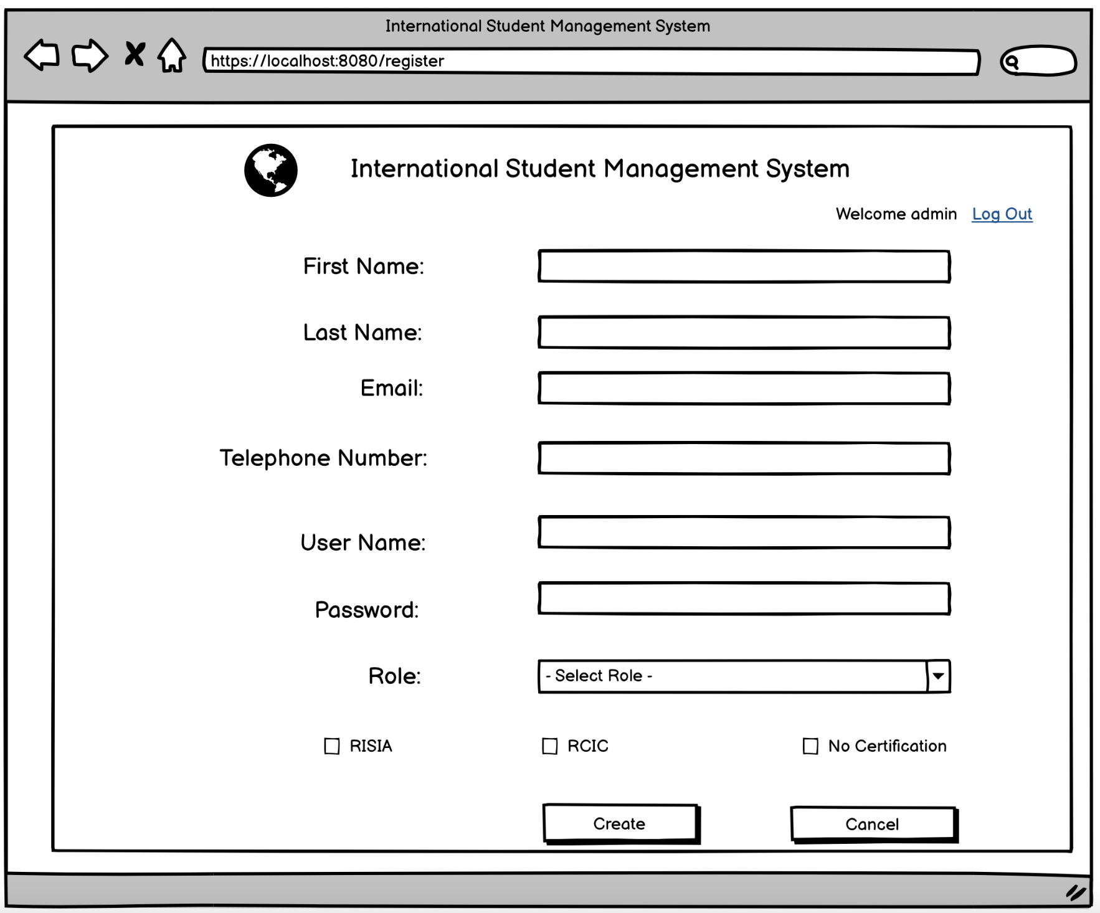
Sprint 1
Analysis and design
Requirements
Release
Workflow
UI/UX design
5
Notes:
Notes....

Slide 6

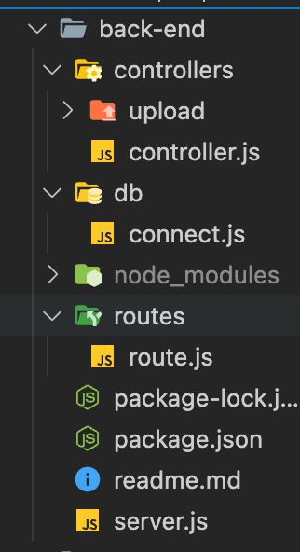


Sprint 2 and 3
Develop back-end
Nodejs
Express
Create database
MySQL
6

Slide 7

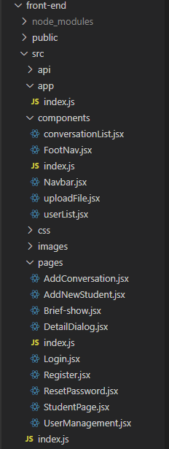




Sprint 2 and 3
Develop front-end
Testing
7

Slide 8
Back-end
MySQL
Relational database
Node
Server
Batch process to import data
8

Slide 9
System presentation
Login
User management
Student management
Note management
9

Slide 10
Conclusion
Fully functional based on user requirement
Provide easy to use product
10

Slide 11
Thank You

